Slide 1
NMF Demo: Lee, Seung
Bryan Russell
6.899 Computer Demonstration

Slide 2
Overview
Training sets
  Faces
  Random noise
  “Block world”
  Cars
Issues/Choices
  Rank
  Number of iterations
  Dataset

Slide 3
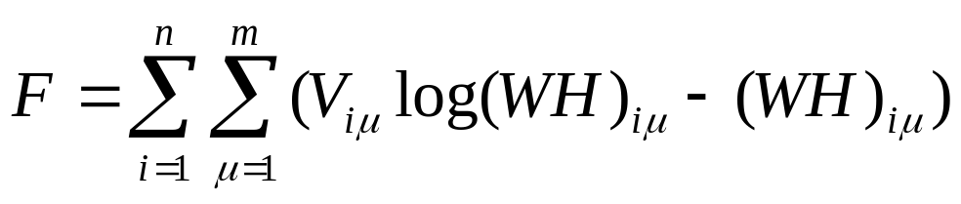

NMF: Equations
Objective Function:

Slide 4
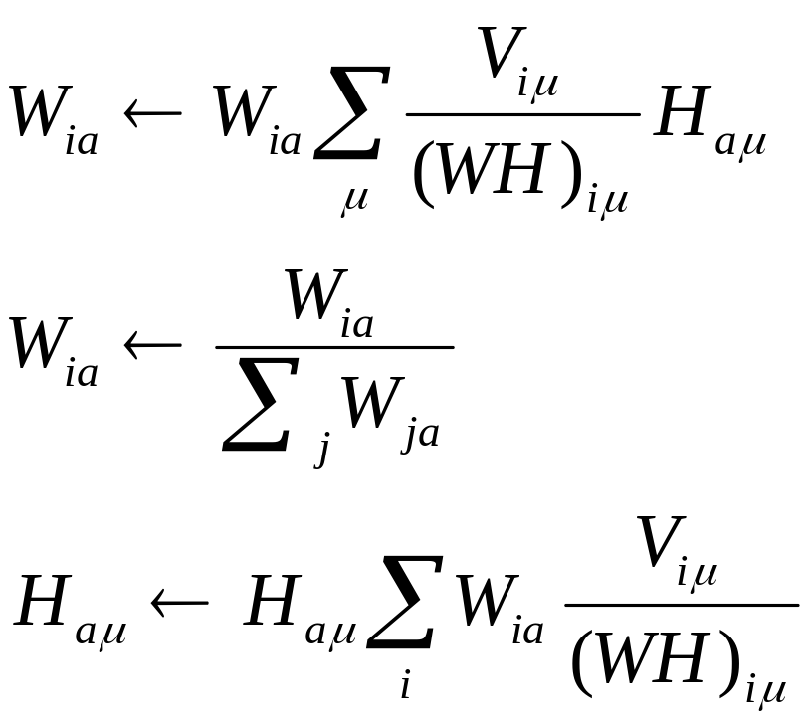
NMF: Equations
Update equations:

Slide 5
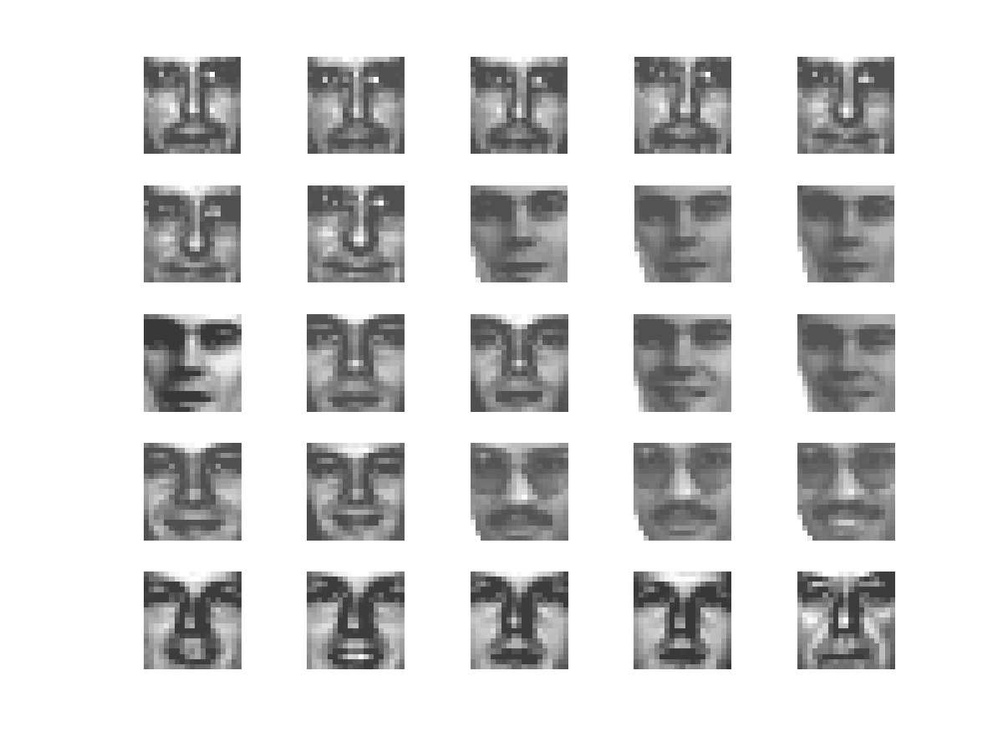
Faces
Training set: 2429 examples
First 25 examples shown at right
Set consists of 19x19 centered face images

Slide 6
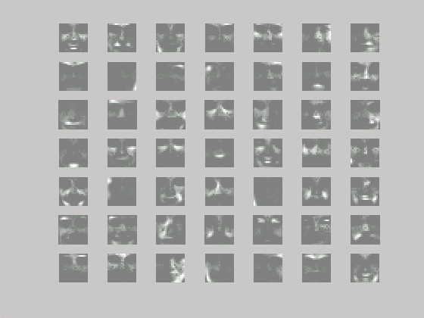
Faces
Basis Images:
  Rank: 49
  Iterations: 50

Slide 7
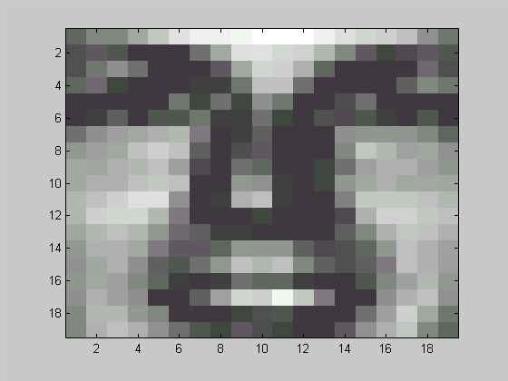
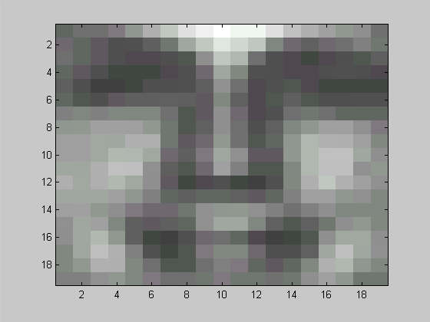
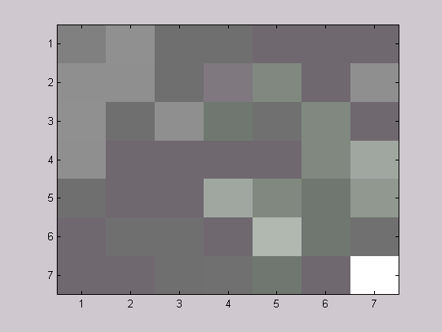
Faces
Original
x
=

Slide 8
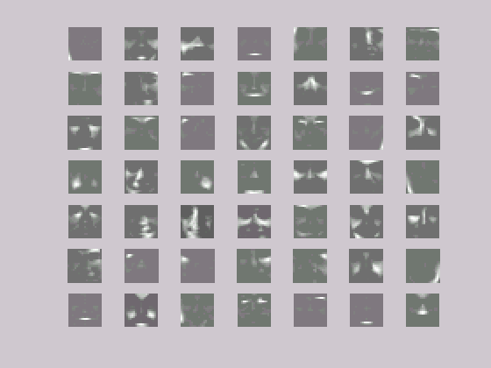
Faces
Basis Images
  Rank: 49
  Iterations: 500

Slide 9
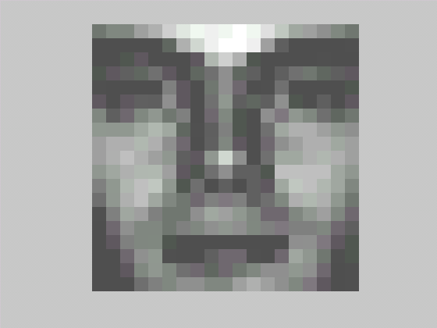
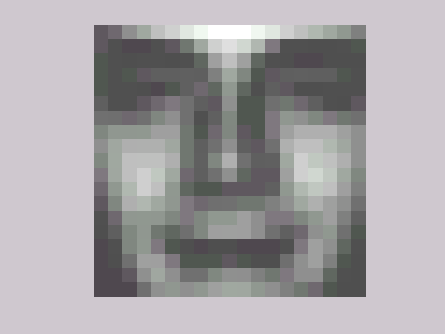

Faces
Original
x
=

Slide 10
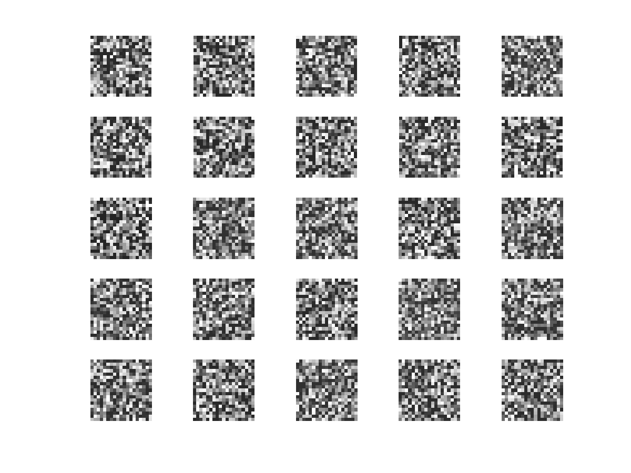
Random
Training set: 2429 examples
First 25 examples listed to the right
Gray-level values generated randomly

Slide 11
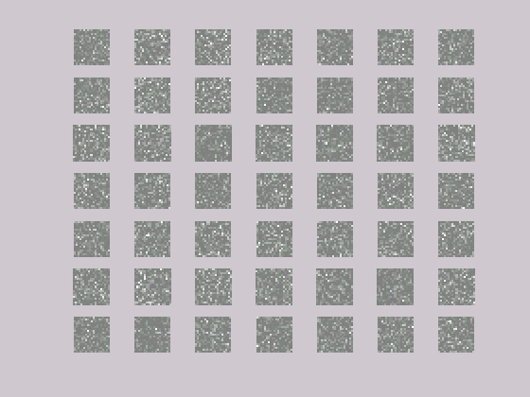
Random
Basis Images
  Rank: 49
  Iterations: 50

Slide 12
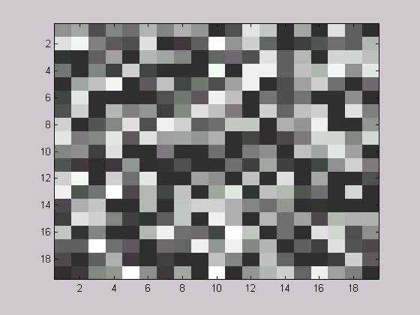
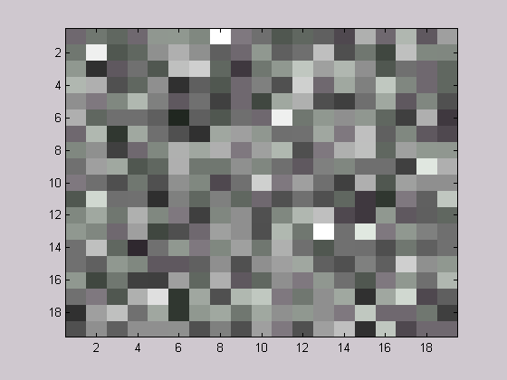
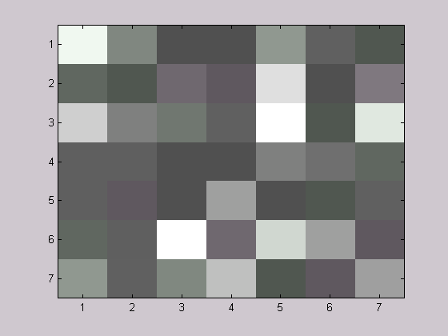
Random
Original
x
=

Slide 13
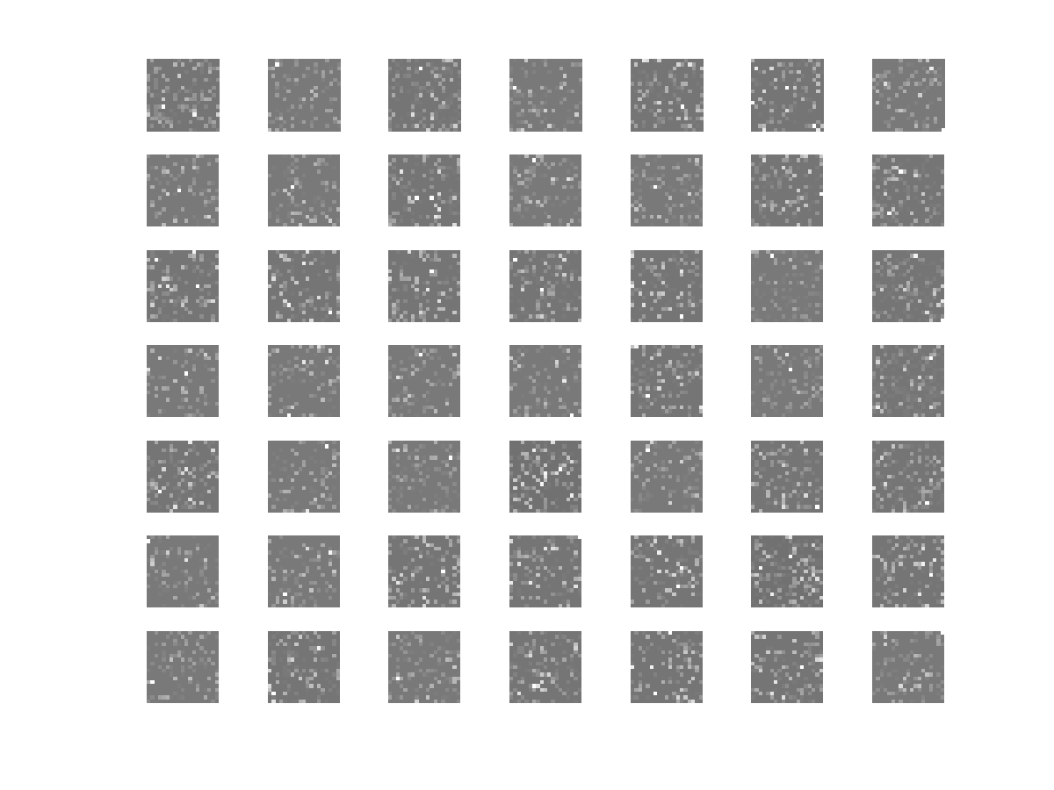
Random
Basis Images
  Rank: 49
  Iterations: 500

Slide 14
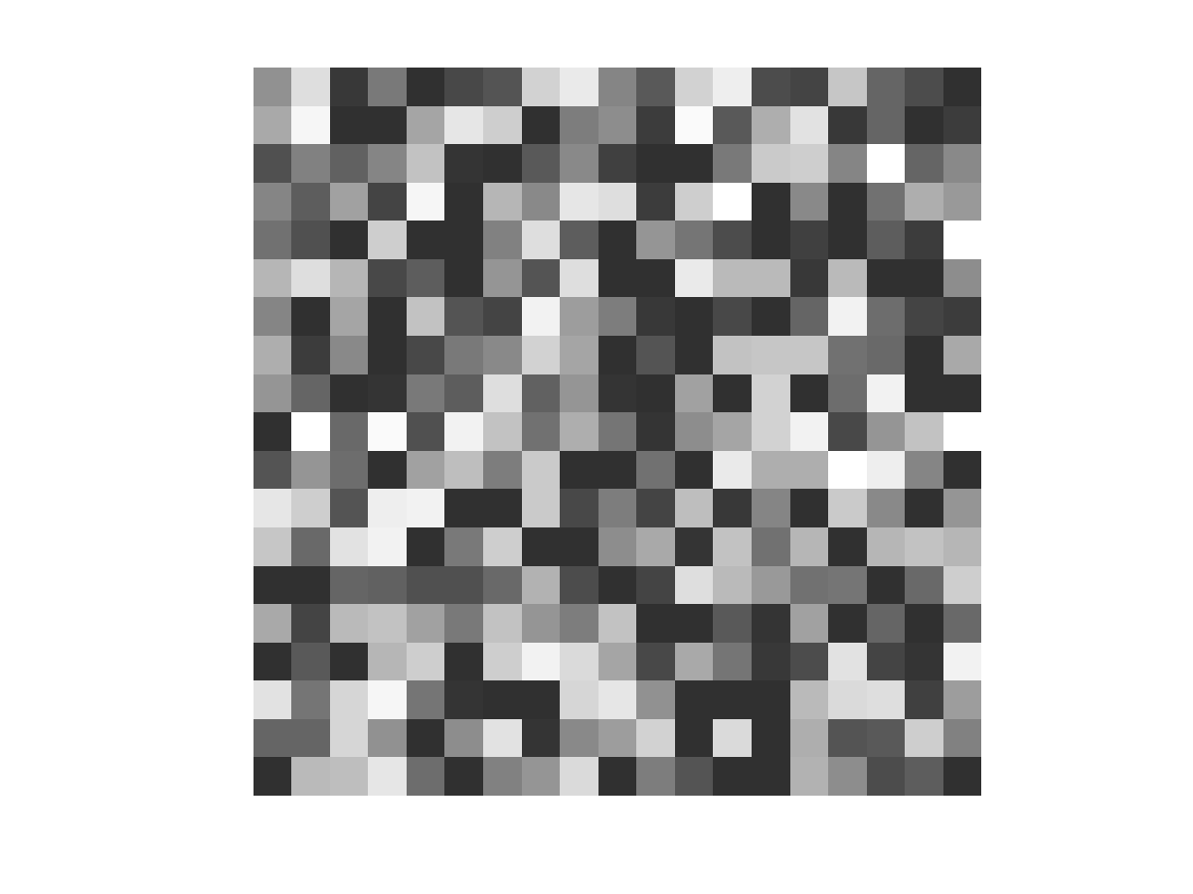
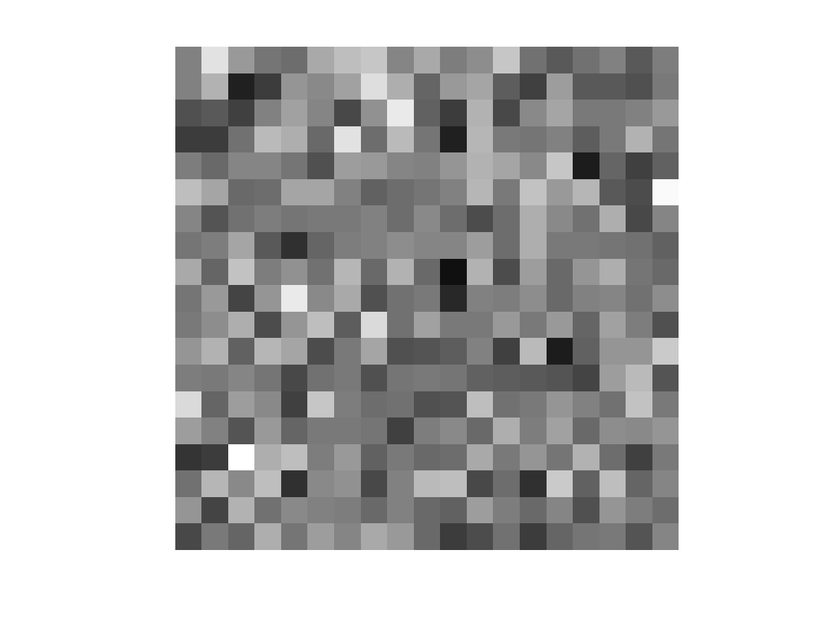
Random
Original
Output

Slide 15
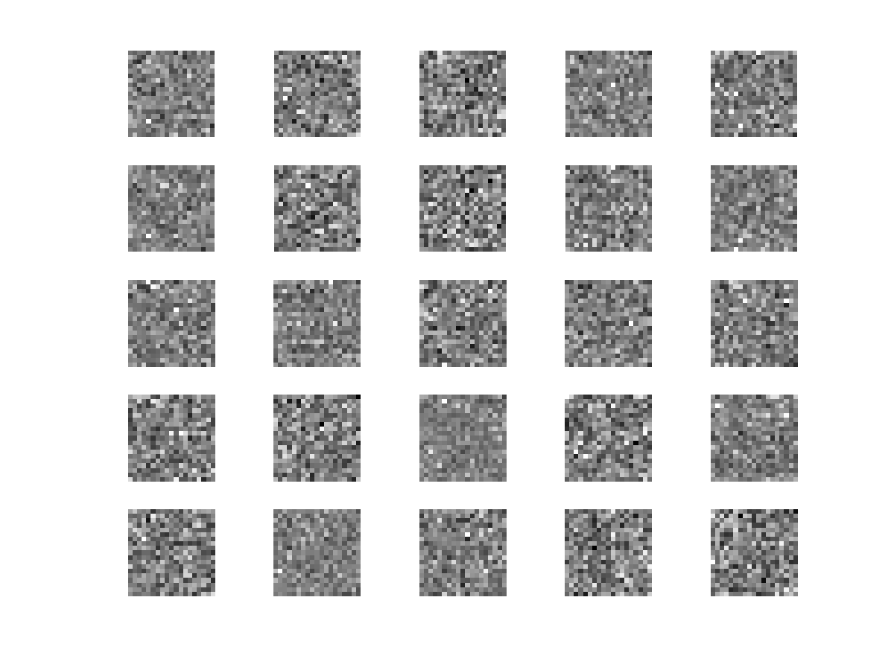
Random
Originals (1-25)
Output (1-25)

Slide 16
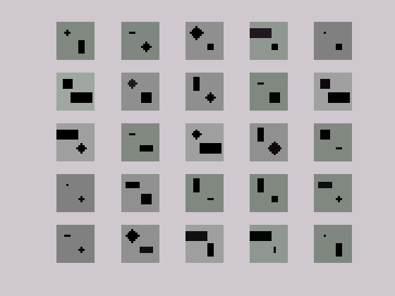
“Blocks”
Training set: 2429 examples
First 25 examples listed to the right
Three “shapes”: squares, rectangles, and circles
Shapes centered at two points in image

Slide 17
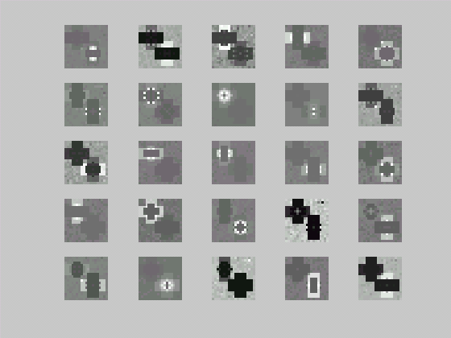
“Blocks”
Basis Images
  Rank: 25
  Iterations: 408

Slide 18



“Blocks”
Original
x
=

Slide 19
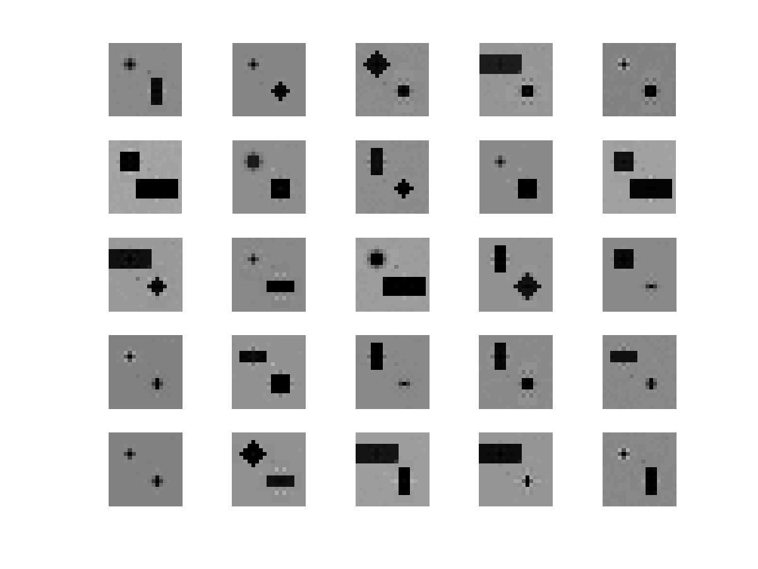
“Blocks”
Originals (1-25)
Output (1-25)

Slide 20
“Blocks”
Output (1-25)

Slide 21
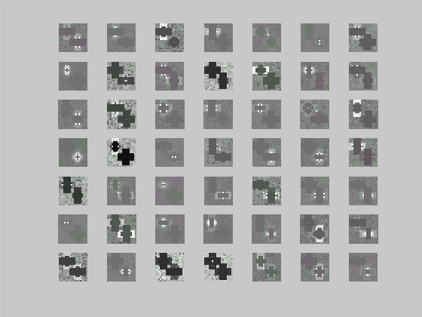
“Blocks”
Basis Images
  Rank: 49
  Iterations: 345

Slide 22
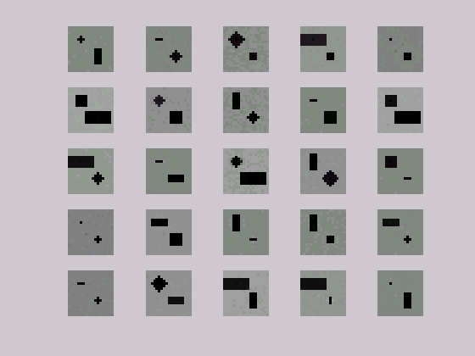
“Blocks”
Originals (1-25)
Output (1-25)

Slide 23
“Blocks”
Output (1-25)

Slide 24
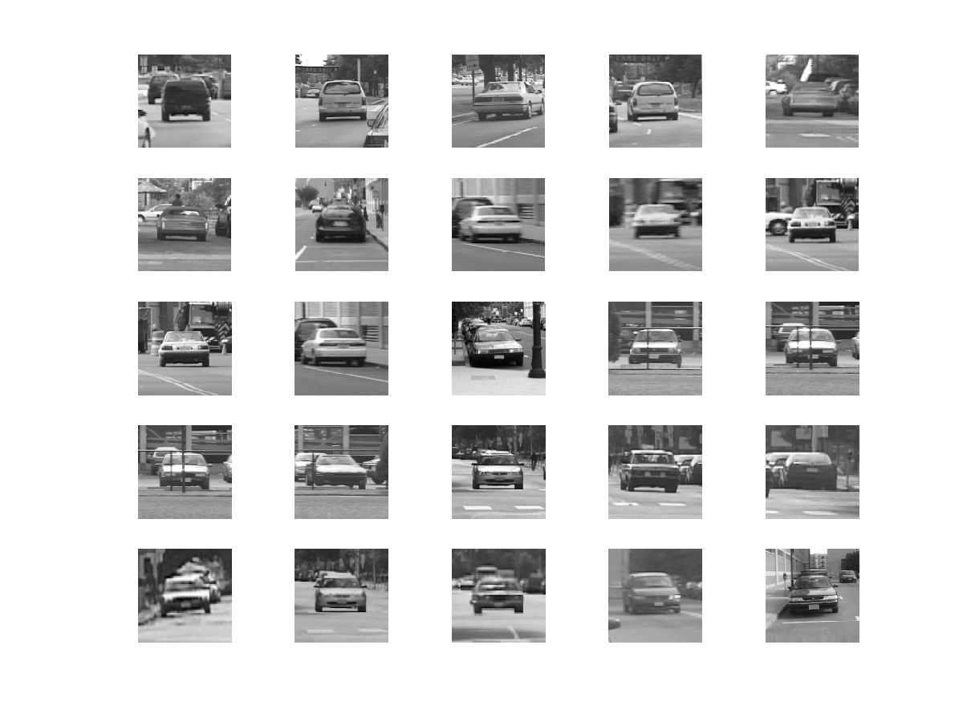
Cars
Training set: 200 examples
First 25 examples shown at right
Set consists of car images taken at various orientations

Slide 25
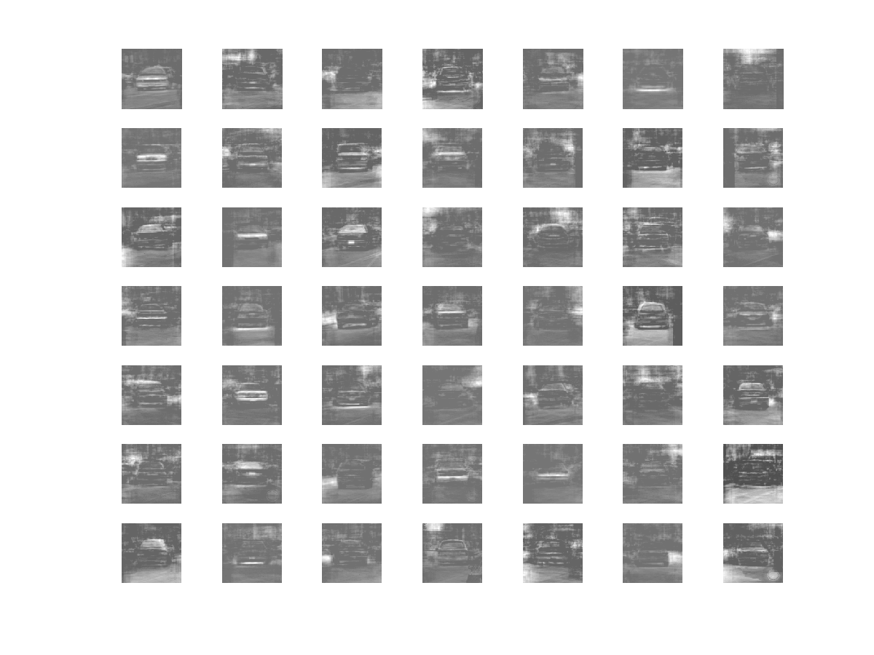
Cars
Basis Images
  Rank: 49
  Iterations: 310
  Number of samples: 200

Slide 26
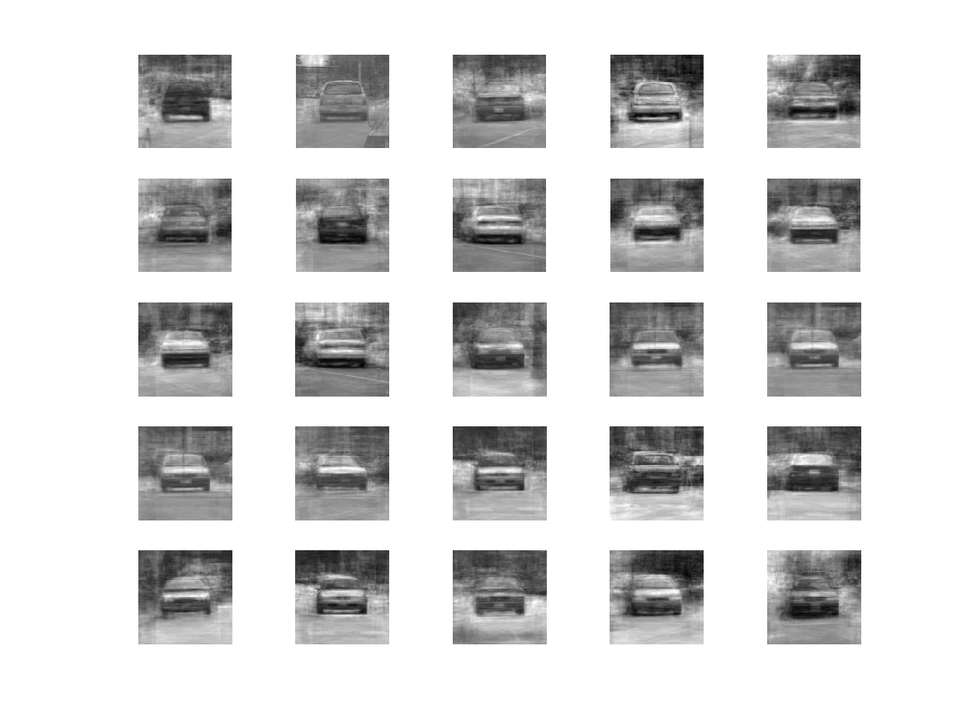
Cars
Originals (1-25)
Output (1-25)

Slide 27
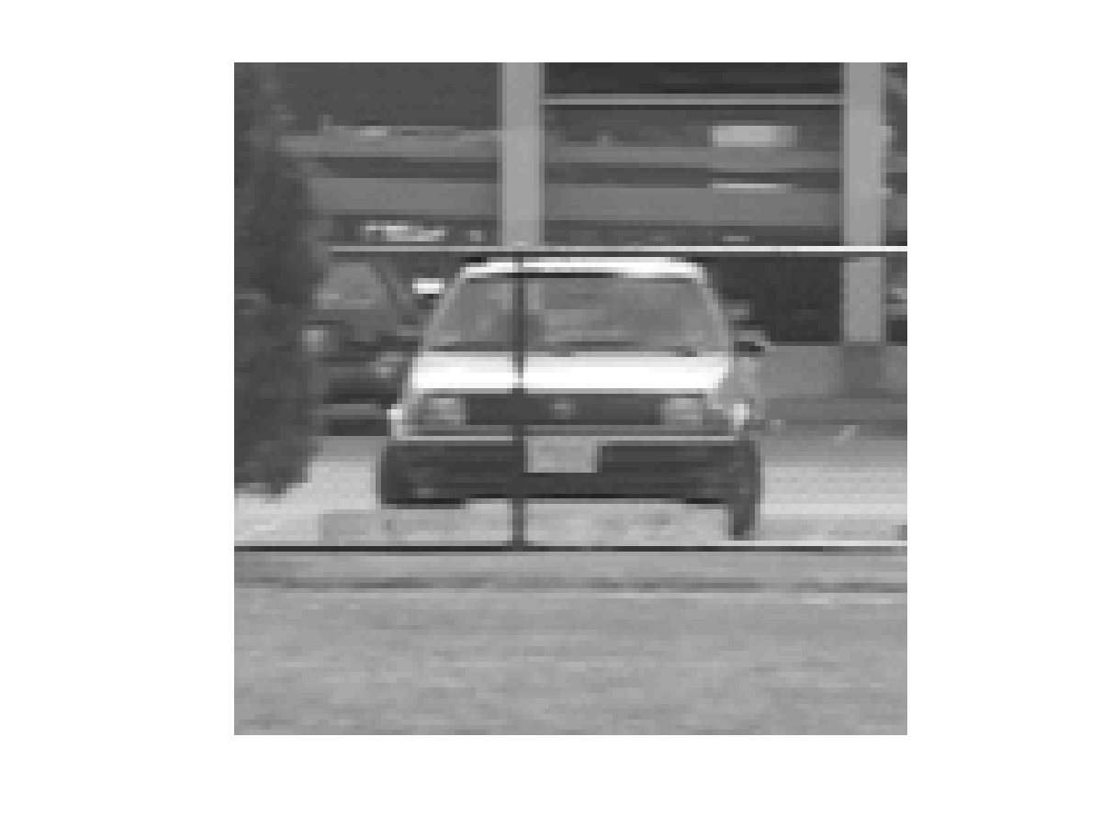
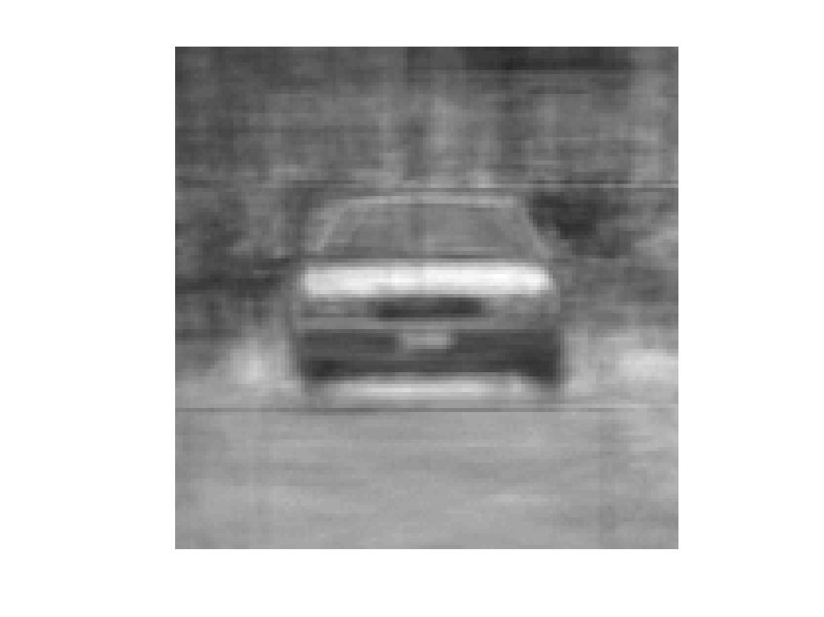
Cars

Slide 28
Thanks!
CBCL for providing face and car images

Slide 29
For code and data, go to:
www.ai.mit.edu/~brussell/courses/6.899/nmf

